Slide 1
GENDER SENSITIZATION
Ms. Khushbu Prasad
Assistant Professor
Amity Law School, Amity University Patna

Slide 2
Sex and Gender

Slide 3
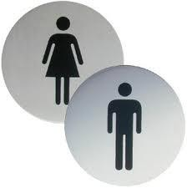
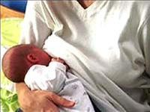
Sex
Sex
indicates
biological
characteristics of man and woman .
People are born male or female. With very few exceptions they remain male or female throughout their lives in terms of their biological make-up.
The biological differences between men and women are identified at birth. For example: only women can give birth; only men can have sperms …

Slide 4

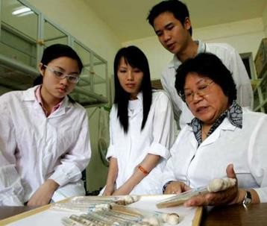
Gender
Gender indicates the characteristics, positions and roles of man and woman in all social relationships.

Slide 5
Gender and Sex
"Sex" refers to the biological and physiological characteristics that define men and women.
"Gender" refers to the socially constructed roles, behaviours, activities, and attributes that a given society considers appropriate for men and women.
To put it another way:
"Male" and "female" are sex categories, while "masculine" and "feminine" are gender categories.

Slide 6
Exercise
A series of statements are given below. After each statement, the participants have to decide whether the characteristic/behavior in the statement is gender or sex
Each participant must decide for themselves without discussing it with others.
There is no right or wrong response and the participants should freely choose whatever they think is correct according to them. Following are the Statements:

Slide 7
Following are the Statements:
Yes Its Gender
No its Sex
Men do not need tenderness and are less sensitive than women
Most drivers in AP are men
Women give birth to babies men don’t
Care of babies is the responsibility of
women
Only women can breastfeed babies
Men have moustache
Women cannot carry heavy loads
Women are scared of working outside their homes at night
Men’s voices break at puberty women’s don’t
Women are emotional and men are
rational
Most of the women have long hair and men have short hair
Most scientists are men
Cooking comes naturally to women

Slide 8
Difference Between Gender and Sex
SEX GENDER
Biologically determined
Universal for all human beings
Unchanging
Inborn (by Birth)
Constructed by society
Multi-faceted differs within and between cultures
Dynamic, changes over time
Acquired

Slide 9
Gender roles and stereotypes
Gender role is the behaviors, attitudes values, beliefs and so on that a particular cultural group considers appropriate for males and females on the basis of their biological sex. Gender roles and expectations are learned.
A gender stereotype is a product of a subjective perception built with an aim of confirming a society in which women have a lower status than men. The consequences of these gender stereotypes are gender inequality, the continuous reproduction of gender inequalities and gender based violence.

Slide 10
Gender Roles
Men have greater body mass and strength and are better equipped for hunting, warfare, and land clearing.
Women do tasks that are compatible with pregnancy, breastfeeding, and child care.

Slide 11
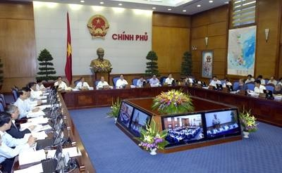
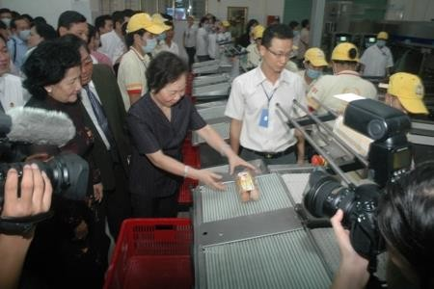

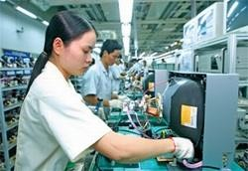
What we see daily…

Slide 12
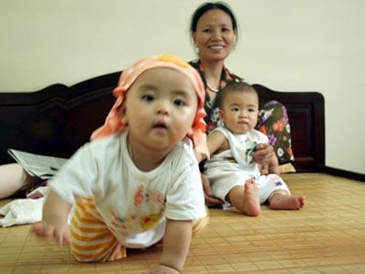
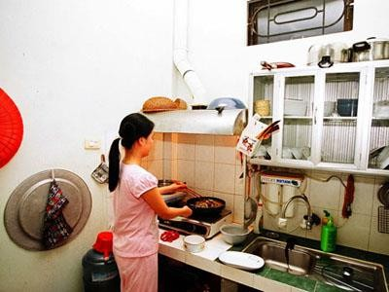
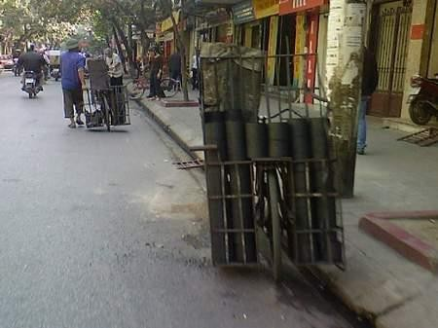

What we see daily…

Slide 13
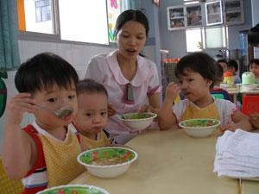
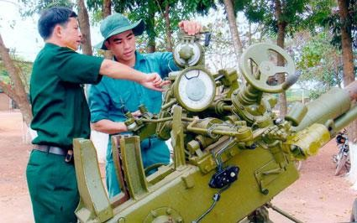
What we see daily…

Slide 14
Quick quizz
Those pictures refer to sex or gender?
Gender
What do they talk about men and women?
Their job/ what they do

Slide 15
Gender roles
Refer to the activities that men and women actually do; can be changed at a time, conditions and situations.
Productive roles: refers to the work of generating income that men and women do, to make products or services as well as process raw materials to get income.
Reproductive roles: refers to the childbirth and other related activities, that most of the time is spent for taking care of the family members and community, searching fuel and water, preparing food, taking care of the child, education and taking care of the seniors, which are almost unpaid.

Slide 16






Women’s 3 main roles (paid & unpaid)
Productive role (Farming, producing):
referring to the production activities that
women do for the market and for their family to generate income
(paid by money
or products)
Reproductive role (house chores/ caring for family) :
Referring activities to caring and maintaining the basic needs of family and its member such as : food, shelter, education, healthcares
→ reproduce production + taking care of potential workforce
Community management role
Referring to the
activities that women do to ensure the supply of resources at community level as an extended role of reproductive role (rituals, ceremony celebration, community services activities…)

Slide 17
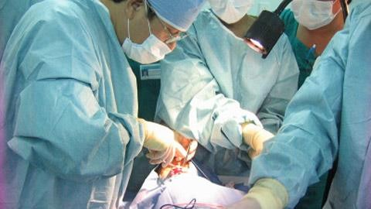
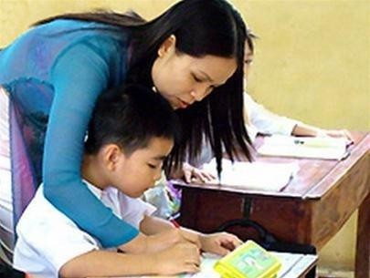
What we often hear…
Women should be teachers, nursery teachers
Only men could be excellent surgeons

Slide 18
Gender stereotype
is negative and partial attitude acknowledgement and assessment of the characteristics, position, role and capacity of man or woman.
Are viewpoints from others assuming that men or women are able to do or should do, unable to do or should not do something

Slide 19
What do those saying mean?
In some families:
Girls cant pursue higher education/ should not be invested in girl’s education such as for boys
Boys shouldn’t do housework- they are very tiny and worthless jobs
Girls can not inherit;
In some workplaces:
Male workers should take the heavy and hazadours jobs ( according to the list of prohibited female workers)
Can’t recruit female workers who have little children/ or give those women lower wage

Slide 20
Question
Those sayings are just prejudice or already become specific actions?

Slide 21
Gender stereotype
is negative and partial attitude acknowledgement and assessment of the characteristics, position, role and capacity of man or woman.
Are viewpoints from others assuming that men or women are able to do or should do, unable to do or should not do something

Slide 22
What do those saying mean?
In some families:
Girls cant pursue higher education/ should not be invested in girl’s education such as for boys
Boys shouldn’t do housework- they are very tiny and worthless jobs
Girls can not inherit;
In some workplaces:
Male workers should take the heavy and hazadours jobs ( according to the list of prohibited female workers)
Can’t recruit female workers who have little children/ or give those women lower wage

Slide 23
Question
Those sayings are just prejudice or already become specific actions?

Slide 24

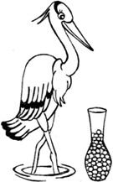

Slide 25
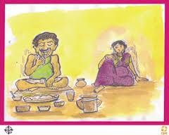
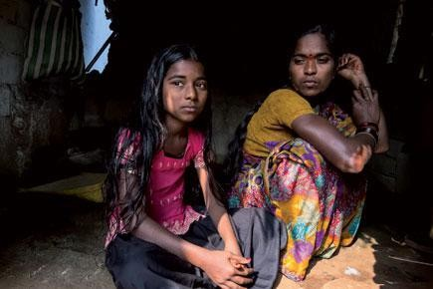
Who Says Boys and Girls are Equal?
A recent survey highlighted the fact that when young school boys were asked who should sacrifice the meal in case it fell short on the table, most replied the mother as the first choice, followed by the sister.
So who is responsible for a male holding the view that the first person to sacrifice a meal should be the mother and followed by the sister, as the second choice?
Why male members are served meal first, in many homes, and the female members forced to eat what’s left?

Slide 26
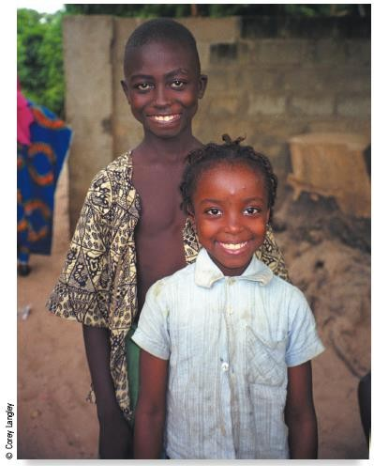
Gender and Education
This boy from Gambia
(west more
Africa) is much likely to attend
school than his younger sister.

Slide 27
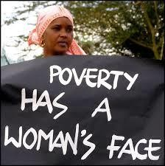
Feminization of Poverty
Refers to the high
proportion of female-
below
headed families
the poverty line, which may result from the high proportion of women
found with
in occupations low prestige and
income.

Slide 28
Exploitation Caused By Gender Ideology
Male gender bias
  A preference found in some societies for sons rather than daughters.
Female infanticide
  The killing of female children
Nutritional deprivation
  A form of child abuse involving withholding food; can retard learning, physical development, or social adjustment.

Slide 29
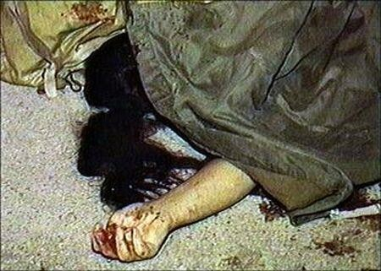
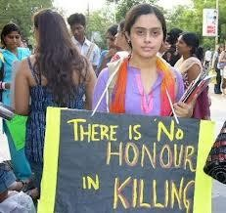
Honor Killings
A euphemism referring to a practice found in various Middle Eastern cultures whereby women are put to death at the hands of their own family
members because
they are thought to have
dishonored the family.

Slide 30
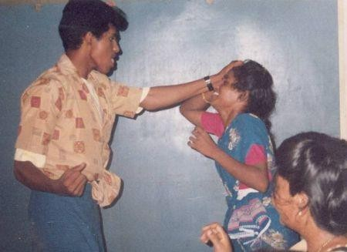
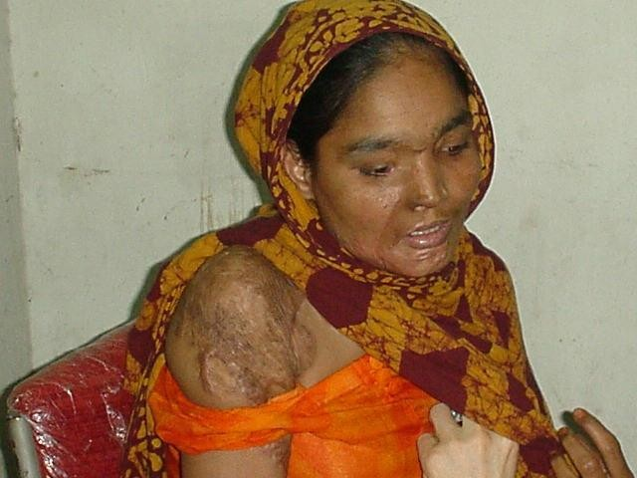
Violence against women - a global pandemic
Physical violence against women, the result of gender ideology, continues to be a problem..
At least one out of every three women has been beaten, forced into sex or otherwise abused in her lifetime.
Every year, millions of women are raped by partners, relatives, friends and strangers, by employers and colleagues, soldiers and members of armed groups.
The World Health Organization has reported that up to 70% of female murder victims are killed by their male partners.

Slide 31
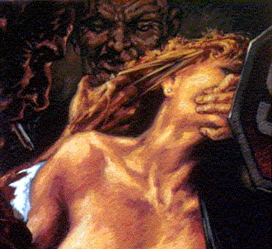
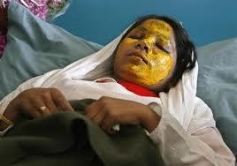
RAPE
Rape (Sec. 376 IPC) (Incidence 22,172)
Madhya Pradesh has reported the highest number of Rape cases (3,135) accounting for 14.1% of total such cases reported in the country.

Slide 32
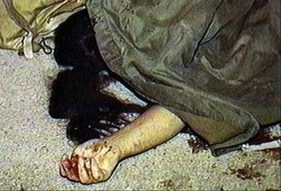
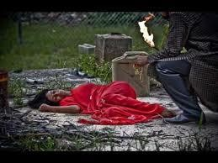
Dowry Deaths (Sec. 302, 304B IPC)
The killing of a wife by her in- laws if the wife’s parents fail to pay additional dowry.
(Incidence 8,391; Rate 0.7) 26.4% of the total such cases reported in the country were reported from Uttar Pradesh (2,217) alone followed by Bihar (1,257) (15.0%).
The highest rate of crime (1.3) was reported from Bihar as compared to the national average of 0.7.

Slide 33
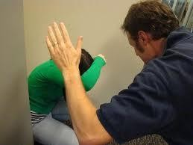
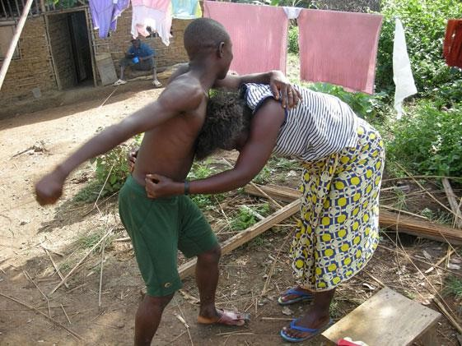
Torture (Cruelty by Husband & Relatives) (Sec. 498 A IPC)
Incidence 94,041;
(Rate 7.9)
18.9% of these were reported from West Bengal (17,796). The highest rate of 26.0 was reported from Tripura as compared to the National rate at 7.9.

Slide 34
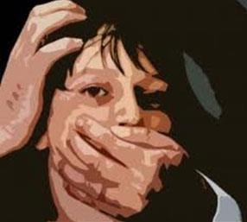
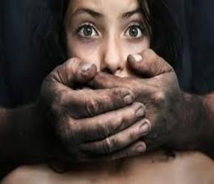
Molestation (Sec. 354 IPC)
(Incidence 40,613;
Rate 3.4)
Madhya Pradesh has reported the highest incidence (6,646) amounting to 16.4% of total such cases.

Slide 35
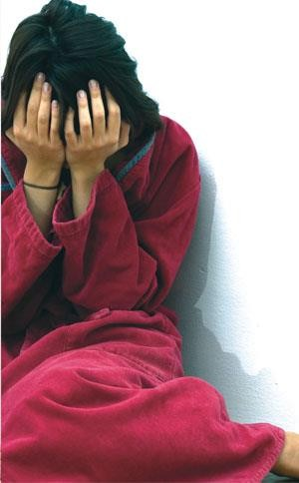
Sexual Harassment (Sec. 509 IPC)
(Incidence 9,961;
Rate 0.8)
Andhra Pradesh has reported 45.8% of cases (4,562) followed by
Maharashtra 11.8%
(2,524). Andhra Pradesh has reported the highest crime rate 5.4 as compared to the national average of 0.8.

Slide 36
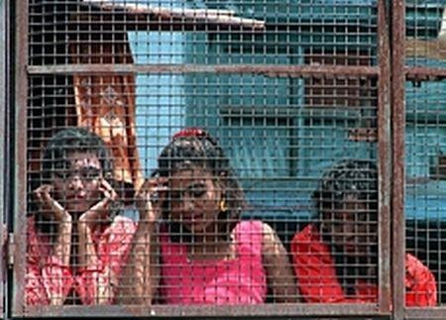
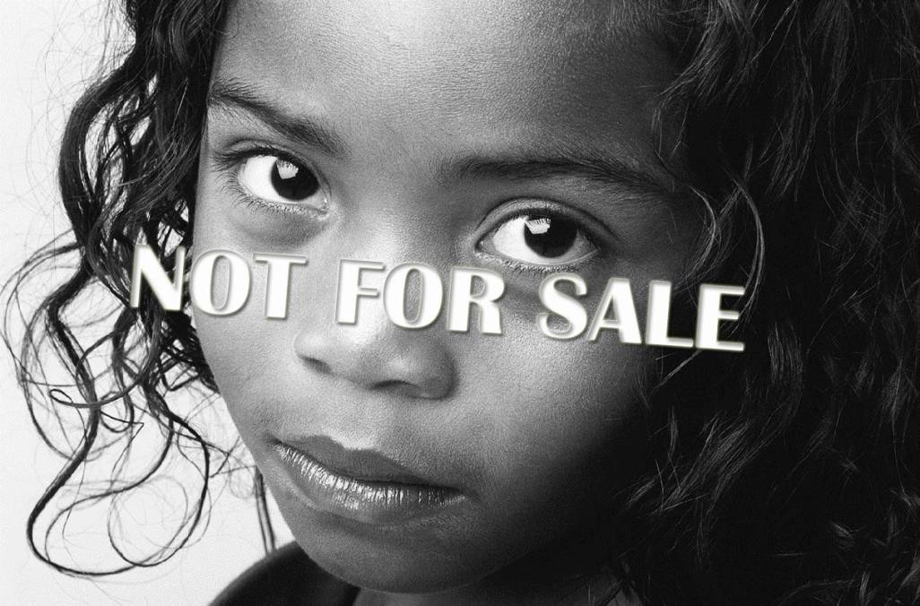
Importation of Girls (Sec. 366-B IPC)
(Incidence 36)
36 cases were
reported during the
as
year 2010
compared to 48 cases in the previous year (2009).

Slide 37
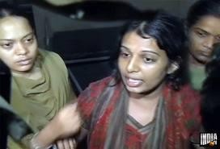
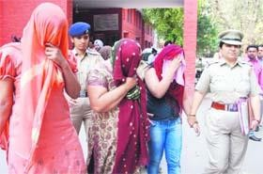
Immoral Traffic (Prevention) Act
(Incidence 2,499;
Rate 0.2)
22.7% (567) cases were reported from
Tamil Nadu and Andhra
Pradesh
for
accounted
21.9% (548).

Slide 38
Gender Issues

Slide 39
WHAT IS A GENDER ISSUE?
A problem that arises from your being a man or a woman
Hinders the attainment satisfying life
A concern of everyone
of a full and

Slide 40
FAMILY
Domestic violence
Multiple burden
Family abandonment by husband
Financial abuse
Household chores assigned to women
Incest

Slide 41
INDIVIDUAL
Lack of GAD awareness
Passivity/resistance to change
Lack of awareness on reproductive rights
Low self worth

Slide 42
HEALTH & NUTRITION
Lack of info on Family Planning/reproductive health
Low level of men participation in health concerns
Lack of health facilities for women
Women are prone to infectious diseases
Lack of social services
Low nutritional level of women
Responsibility of birth control lies on women

Slide 43
SOCIO-CULTURAL
Commodification of women/ prostitution
Women considered as sex objects · Double-standard of morality
Stereotyping in media, educational system
Rape
Sexual harassment/abuse
Domestic violence
Cultural subjugation
Poor education of women
GAD awareness for students & teachers
Women viewed as the weaker sex
Poor social life of women

Slide 44
Education
Low level of literacy among women
Number of girl students is considerable lower than the number of boy students.
Even girls who do enrol in school may have irregular attendance due to other demands on them, and the fact that their education may not be prioritised.
Girls are more likely to repeat years, to drop out early and to fail in key subjects, and in most countries girls are less likely to complete the transition to secondary schooling
Increase in girl child labour

Slide 45
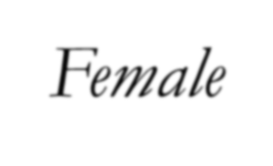
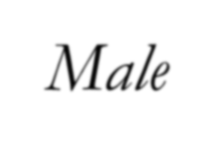
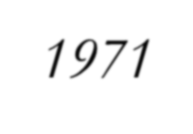
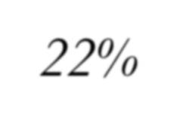
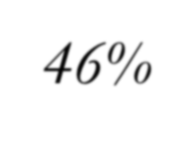
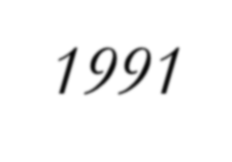
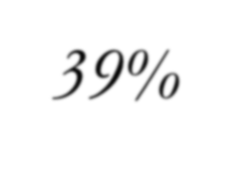
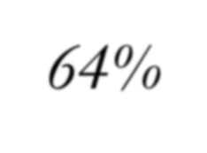
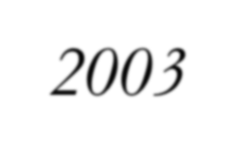
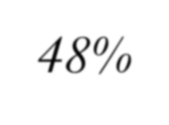
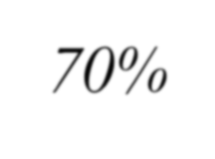
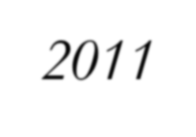
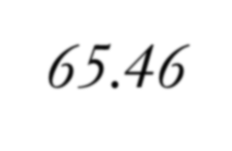
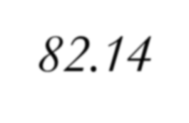
Indian Women in Modern Times
Education
Literacy
  Gender gaps:
    Differences across states
(Kerala has highest female literacy; Rajasthan, Bihar and Uttar Pradesh have the lowest)
    Differences between rural and urban areas
    Parental preference for boys going to school
    Higher dropout rate among
girls
 | Female | Male
1971 | 22% | 46%
1991 | 39% | 64%
2003 | 48% | 70%
2011 | 65.46 | 82.14

Slide 46
Indian Women in Modern Times
Education
Gender gaps in higher education
  About 1 percent of total women population has college education
  Women account for a third of the students at
college/university level
  In engineering and business, the proportion of female students is much smaller
  In education, nearly half of the students are women

Slide 47
Indian Women in Modern Times
Barriers to Female Education
Poverty: one-fourth of India’s population lives below the poverty line (2002)
Social values and parental preferences
Inadequate school facilities
Shortage of female teachers: 29 percent at the primary level and 22 percent at the university level (1993)
Gender bias in curriculum

Slide 48
Indian Women in Modern Times
Employment
Difficult to get an overall picture of employment among
women in India
  Most women work in the informal sector
Women accounted for only 25.6percent of the total workers (Work Participation Rate) in 2011
The number of female workers has increased faster than the number of male workers
Female unemployment rates are similar to male unemployment rates

Slide 49
Indian Women in Modern Times
Barriers to Female Employment
Cultural Restrictions
  Hierarchical society (caste system)
  Purdah system: the veiling and seclusion of women
Discrimination at Workplace
  More prevalent in fields where male competition is high
  Less prevalent in fields where competition is low
Lack of employment opportunities

Slide 50
Indian Women in Modern Times
Empowerment
Social Empowerment
  Education
    There is no direct relationship between education and work force participation; but may affect their participation in household decision making
  Economic Independence:
    Economic independence does not imply significant improvement in social standing
    Culture and tradition play an important role
    A small fraction has opened up towards Western values

Slide 51
Indian Women in Modern Times
Economic Empowerment
  Property Rights
    Patriarchal society
  Economic Decision Making
    In the household
    In businesses

Slide 52
Indian Women in Modern Times
Political Empowerment
  Representation in democratic institutions
  Government reservations policy for women: the constitutional amendment of 1990s
  The current Lok Sabha has 63 out of 543, or 11.6% women

Slide 53
ECONOMIC
Unemployment/limited opportunities for women
Child Labor
Employment preferences for women
Child trafficking/slavery
Lack of credit programs for women
Women not given managerial positions
Increase burden of women due to poverty
Women's work are unseen
Insufficient funds and other resources
Inequality of fund allocation

Slide 54
LEGAL/ADMIN/GOV'T
Ignorance on laws affecting women
Lack of trained personnel to handle rape, VAW, incest
Insensitivity of judges, police
Justice system grinds slowly
Lack of focal persons
Lack of gender planning
Poor dissemination of GAD issues

Slide 55
POLITICAL
Subordination from politicians/ authorities
Lack of awareness/participation of women in decision-making
Limited participation of women in electoral process

Slide 56
Gender and the legal system

Slide 57
Response of Police Personnel to increasing Violence against Women
The police response to violence against women continues to be grossly inadequate and inappropriate
The cult of masculinity prevalent in the department makes the police officers hold some stereotypes about violence against women

Slide 58
Indifferent attitude/behaviour towards women
The general public including women come in contact with the policemen primarily at the police station and lower levels.
Generally speaking, the main problems faced by the women are indifferent and rude behaviour of the policemen, their unhelpful attitude and reluctance to register crime on their complaints and lack of any promptitude on their part to redress their grievances.
Most of them even demand bribe for taking any action. There are also large scale complaints of molestation of women by the policemen.

Slide 59
Some Stereotypes about sexual violence/harassment
Rape is victim-precipitated. Women ask for rape/sexual violence by provocative mode of dress and behaviour or by going out after dark or going to shady and lonely places.
Women subconsciously desire rape and ‘cry rape’ only when they are caught.
Rape cannot occur if a woman resists.
Women’s place is at home. If they go out, they must take what comes their way.
Sexual harassment at work place and eve-teasing are fun and women enjoy it.
Male sexuality is an uncontrollable force. W omen should not arouse it.

Slide 60
Standard police response
Initial complaint
is disbelieved and action is
to
contemplated only after a value judgement as
whether the woman is deserving of appropriate police response.
Victim is discouraged from pursuing complaint.
Intensive bullying, callous interrogation and aggressive and sexist questioning.
Medical examination is delayed and conducted in unpleasant and threatening surroundings.
Victim is not supplied with basic information about her legitimate rights and support services available to her.

Slide 61
Stereotypes governing domestic violence
Family is a private place where men have some legitimate rights.
Husband has a marital right to discipline his wife.
Women are irrational, nagging and provoke men.
Only the poor/uneducated/alcoholic males are violent towards their wives.
Women who deviate from feminine roles of mother and wife warrant discipline.

Slide 62
Standard Police Response
Trivialisation
De-criminalization and illegitimization of domestic violence.
Non-intervention and advising the victims to seek remedies in a civil
court.
Acting as peacemaker and mediator and letting off the male offender with mild, informal threats
Need for police to behave in a gender sensitive manner in dealing
with violence against women.
Because of the several social factors, women are more afraid of crimes than men and fear of crime extends well beyond the women who have themselves been victims.
Further, because of several socioeconomic factors, women victims are differently placed than their male counterparts. In view of the above, there is need for police to act in a gender sensitive manner in all cases relating to violence against women.

Slide 63
Response of Judges
There have been instances when insensitive remarks were made in the judgements about the character and background of victims of rape and other sexual crimes and rather misplaced lenience shown for the accused.
The Supreme Court has taken due note of many such instances, but there is need to eliminate such objectionable remarks.

Slide 64
High Profile cases
On the other hand, we are stunned to read reports of sexual exploitation of young girls by those at the highest echelons of their profession—including
Two retired judges of the Supreme Court, (earlier a Delhi High Court Judge, who had to resign on charges of sexual misdemeanour and corrupt practices in 2003) . The latest being the reported resignation of an additional district judge, Gwalior, because of her alleged sexual harassment by the administrative judge of the Jabalpur High Court;
A minister each from Haryana and Rajasthan;
Former Director Generals of Police, Haryana (molestation of a 13 year-old- girl) and Punjab (misbehavior with a senior IAS woman officer having sexual overtones) – the latest being the alleged sexual exploitation of a female model in Mumbai by a DIG of Police; an all-powerful editor-in-chief of a well-known media channel, known for sting operations exposing high and mighty; a self-proclaimed septuagenarian godman with lakhs of followers and another self-proclaimed young godman operating in south India.

Slide 65
Gender Bias in Media
Globalisation, Opening of markets and the comodification of women
Change in the structure of Indian media -increase in advertising, revenue, cut throat competition between multinational companies and the direct targeting on women & children as consumers through T.V. programmes.
Gender bias in print and visual media
Misrepresentation of women

Slide 66

Misleading Advertisements
In an advertisement, the lady of the house is shown doing all the household chores while catering to the beck and call of all the other members of the family.
A backache forces her to takes a break from her work. The family acknowledges her presence by passing on a tube of a pain reliever which the husband offers to apply on her.
After a short respite she is back on her feet catering to the orders and requests from her family. The message has been rightly conveyed – that of the docile, subservient nature of the woman. She is being reduced to an object for ‘satisfying needs.

Slide 67

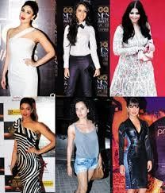
Poor portrayal of Women
Indian media gives low priority to the subject of portraying women as equals in the society.
The Indian media likes nothing better than to see their womenfolk as home-makers and a compulsive buyer who buys the latest dress, shoes, accessories, cosmetics, mostly at the expense of her husband’s money.
Although it purports to show them as independent characters, the media actually portrays them as consumers rather than as modern, liberated women.

Slide 68


Women as Objects
The portrayal of women as sexual objects can be glaringly seen in the various ‘Item numbers’ which has almost become almost mandatory for a film to become a hit. Hindi films reveals the sheer quantity and variety of violence directed towards them.
Women in Bollywood films are often portrayed as screaming, yelling and crying ‘types’ as they react to stressful situations. Assertive women in movies are often tagged as ‘bad’ while men, in all shades of character are considered ‘heroes’.
The Indian audience also must be partially blamed for the acceptance of such mistreatments of women in movies.

Slide 69
Differential treatment of Women
Even in interviews, there is differential treatment for women. Men giving interviews are often made to elaborate on their work and their marital status or their dress sense remains irrelevant.
Women achievers on the other hand are subject to irrelevant and distasteful queries - details of her looks, her private life and such trivia as her fondness for beautiful sarees, her decision to stay single or otherwise is scrutinized.
According to the media, a successful woman somehow is a feminist. When Phoolan Devi was once interviewed, she was first shown serving food to her husband.
Men give most of opinion on exit polls during elections. They were also the ones whose opinions mattered the most on the issue of reservation of seats for women in Panchayats. Women, whose future they were deciding, sat as silent spectators.

Slide 70
Differential treatment of Women
Media influences the social image and the self-image of women. Media affects the choices they make, what they eat and what they wear. It influences their behavioral attitude, their learning process, and ultimately what they become.
Media has clearly discouraged the emergence of a new confident, assertive woman. Such differential media treatment increases their isolation, disempowers them, weakens them. They remain unheard, unrepresented and ‘incommunicable.’
The portrayal of woman in the print media is quite degrading more often than not depicting her as commercial commodity. It is necessary that public should be motivated and sensitized to the issue of criminalization, politicization, and commercialization of women vis-à-vis their projection in the media in a healthy manner

Slide 71
Media to do away with stereotyping
Advertisements, they say reflects the prevailing trends in the society.
A UNESCO report lists the words women are described in the media: ‘the glamorous sex kitten, the sainted mother, the devious witch, the hard-faced corporate and political climber.’
The report of 2009, fears that given the current rate at which stereotyping of women take place, it would take another 75 years to achieve gender equality in the media!
Gender sensitization of the Indian has to be made on a priority basis. Mere reporting of facts and figures would not help in bridging gender differences. It should play a proactive role in inculcating gender sensitivity and ensure that women are not depicted in poor light.

Slide 72
Gender Sensitization

Slide 73
What is Gender Sensitization?
Gender sensitization refers to the modification of behaviour by raising awareness of gender equality concerns.
Gender sensitizing "is about changing behavior and instilling empathy into the views that we hold about our own and the other gender.“
It helps people in "examining their personal attitudes and beliefs and questioning the 'realities' they thought they know.“
Gender sensitization is about making people aware of the need to bring about a quantum change in our mindset which sees man as the bread winner and woman as the house keeper.

Slide 74
Why Gender Sensitization?
Gender sensitivity helps to generate respect for the individual regardless of sex.
Gender sensitivity is not about pitting women against men. On the contrary , education that is gender sensitive benefits members of both sexes.
It helps them determine which assumptions in matters of gender are valid and which are stereotyped generalizations.
Gender awareness requires not only intellectual effort but also sensitivity and open mindedness. It opens up the widest possible range of life options for both women and men.

Slide 75
Why Is Gender Sensitivity Training at Workplace is Important?
The contemporary workplace is very diverse and is becoming more so every day. Employees need to understand, be sensitive, and be able to adapt to the various needs, concerns, and characteristics of a multitude of different people including women.
Gender Sensitivity training will help employees to personally cultivate good interpersonal relationships with members of their team and help facilitate respective and productive group relations among team members.
It helps to develop a cordial and amiable working environment where there is mutual respect and trust between the sexes, without sexual innuendoes and obstructive chauvinism to mar the atmosphere.

Slide 76
Objective Gender Sensitivity Training
The primary objective of gender sensitivity training is to educate you and the other participants about the needs and concerns of women for more constructive behavior that will be beneficial to you and everyone else in the organization.
It helps an individual by providing insight into your behavior and helps you develop corrective emotional and behavioral actions.

Slide 77
Moral Values should start from home
A society can only be progressive if we recognize that it comprises both male and female members of equal value
This is not an issue of who plays what role. Roles can differ from society to society but what is universal is the fact that both males and females have equal relevance and all our decisions and actions that influence our lives must be in the backdrop of gender equality.
It is time we opened ourselves to introspection and recognize the fact that we are a gender biased society, at all levels, and that we must begin to focus on the values of gender parity in our homes.
This is where the first step to being a progressive citizen begins. There can be no better place for moral and ethical education than home and the best student for the same is a child, for he or she is completely open to learning what is taught and practiced at home.

Slide 78
Importance of Gender sensitization
Gender sensitivity helps to generate respect for individual irrespective of sex
It also indicates the many challenges that remain in order to close gender gaps, promote equality in education, employment and other spheres of work and family
According to modern trends, men and women are equally active players in the family, community, and national affairs. Women must be recognized as representing half of the world's most precious resources called human beings.
Employers should commit to equal employment opportunity at workplace and management should not distinguish people on the on the basis of sex. For all management purposes, both men and women are gifted with the ability to work with diligence
Managements must sensitize employees for gender sensitivity to prevent or minimize issues connected with sexual harassment that is illegal and train employees to be more vocal and how to say no to such advances firmly

Slide 79
What is Sexual Harassment?
Sexual harassment occurs when a woman despite having clearly indicated her disinterest, is pressured into tolerating or accepting undesirable sexual advances by someone who is in a position of power over her and is able to harm her interests if she declines to tolerate these advances.
If a boss or a colleague repeatedly makes sexual propositions to a woman employee day after day, with or without any physical overtures, despite her repeatedly indicating that she finds his advances offensive, he can be rightly accused of sexual harassment.

Slide 80
Sexual Harassment at Workplace
Although such extreme conditions are not prevalent in government offices, cases of sexual harassment have been reported time and again.
Job security , conduct rules and other
have
measures taken by the government
gone a long way in curbing sexual harassment in workplaces meant for government employees

Slide 81
Steps taken to curb sexual harassment
Conduct unbecoming of a government servant
New provisions in conduct rules
Case of Vishakha v/s State of Jaipur
Supreme court guidelines issued in 1997-the basis of new provisions in CCS (Conduct) Rules.

Slide 82
Rule 3 (C) of CCS Rules
Rule 3(C) concerns the prohibition of sexual harassment of working women
Enjoins the Government servant
  not to indulge in any act of sexual harassment of any women in the workplace
  in-charge of a workplace to take appropriate steps to prevent sexual harassment to any woman at such work

Slide 83
Sexual Harassment at Workplace - Provisions in CCS (Conduct Rules)
Sexual harassment defined to include such unwelcome sexually determined behaviour (whether directly or by implication) as:
physical contact and advances;
a demand or request for sexual favours;
sexually coloured remarks;
showing pornography;
any other unwelcome physical, verbal or non- verbal conduct of sexual nature.

Slide 84
Steps to be taken by the Employer
Duty of the employer to prevent or deter the commission of acts of sexual harassment and to provide for the resolution, settlement or prosecution of acts of sexual harassment
Criminal proceedings to be initiated in appropriate cases
Where such conduct amounts to misconduct, appropriate disciplinary action to be initiated by the employer

Slide 85
Thank You

